Slide 1
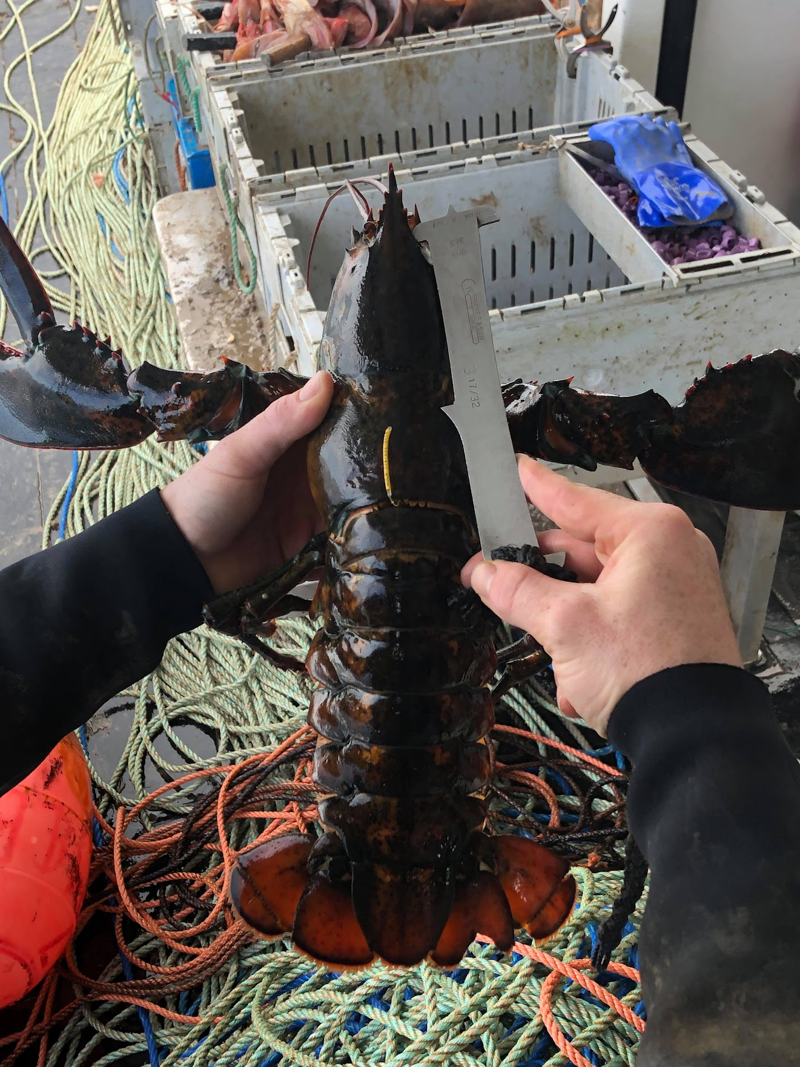




Collaborating across the Gulf of Maine to complete citizen-driven fishery science
Everett Rzeszowski¹, Kathleen Reardon², Heidi Henninger³, Joshua Carloni⁴, Damian C. Brady¹
¹Darling Marine Center, ²ME Dept. Marine Resources, ³Atlantic Offshore Lobstermen’s Association, ⁴New Hampshire Fish & Game

Slide 2
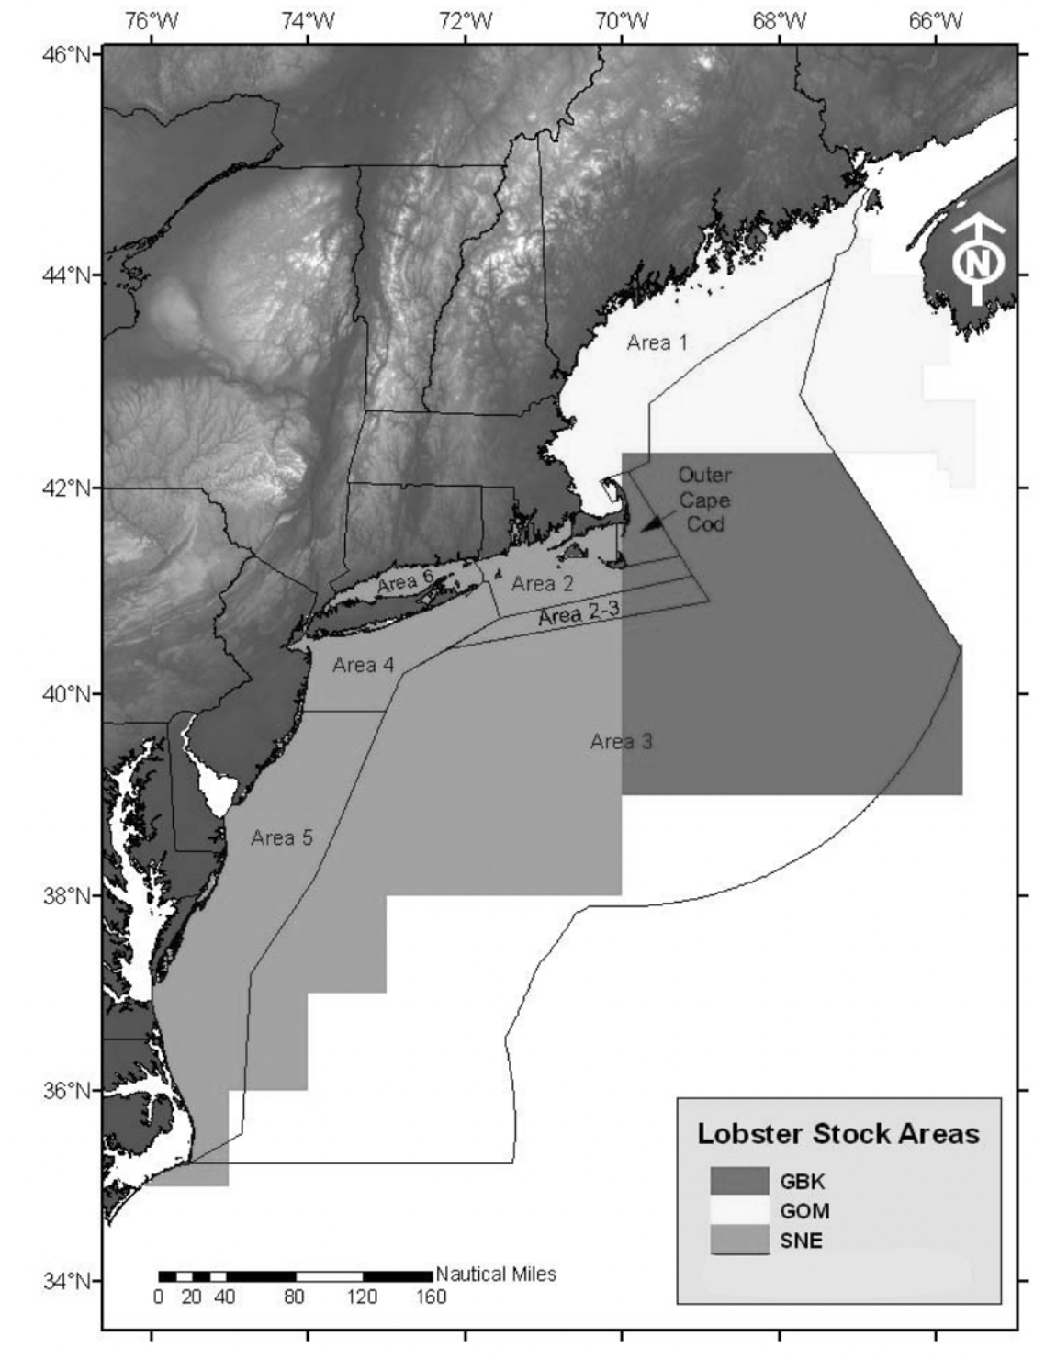
Project Overview
2015-2016 - Georges Bank egger study, funded by ACCSP
2017-2020 - GOM/GB tagging study, funded by NOAA SK
Project Goal: Examine stock connectivity & update growth data, in response to 2015 Lobster Stock Assessment
Today:
Field methods
Developing analytical methods
Successful collaborations
Next steps
Previously defined Stock Units (ASMFC, 2009).

Slide 3
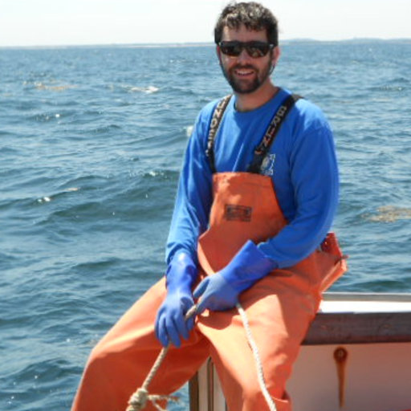
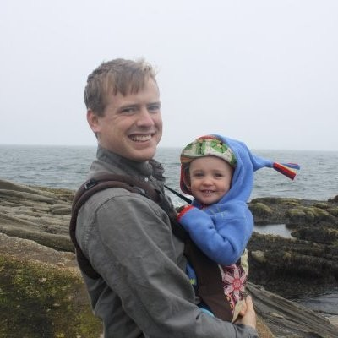
Project Team
Heidi Henninger (formerly AOLA), Co-PI
Joshua T. Carloni (NH F&G), Co-PI
Kathleen M. Reardon (ME DMR), Co-PI
Everett Rzeszowski (Darling Marine Center), student data analyst completing backend analysis.
Damian C. Brady (Darling Marine Center), analysis conceptualization.
The many technicians and fishermen that made the decision to contribute to this data collection effort.

Slide 4
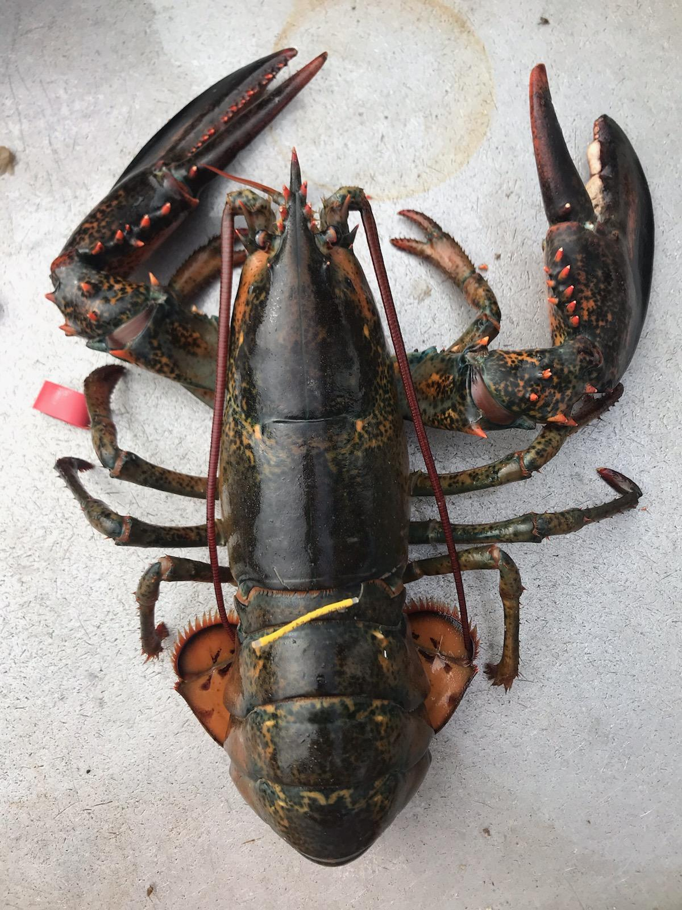
Field Methods
Tagged 18,000+ lobsters with Floy T-Bar tags which lobsters can retain through molt events.
Fishery Dependent:
Oversized, undersized, and reproductive females
Tagged during commercial fishing trips
ME DMR, MRAG Americas and Coonamessett Farm Foundation.
Fishery Independent:
All lobsters
Chartered fishing vessel - dedicated research
ME DMR
Recaptures were reported from 2015 - present. Images included 51 % of the time.
Example tagged lobster (Project image bank).

Slide 5
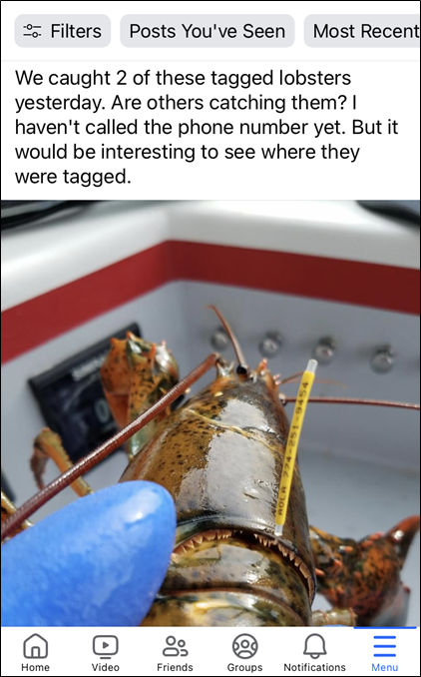
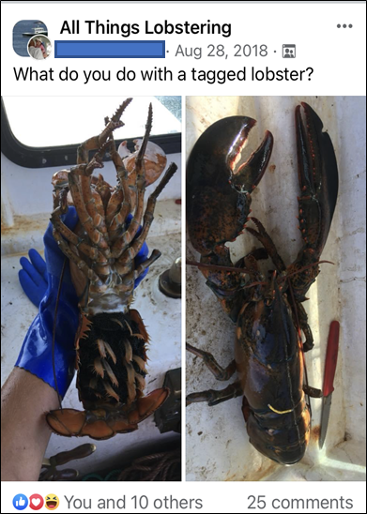
Industry Outreach
Methods of outreach
Industry meetings
Social media outreach
Quarterly award raffles
Radio chatter
Facebook chatter
Sent out custom tag/recapture charts

Slide 6
Analytical Methods
Compare movement characteristics of animals tagged via fishery independent vs fishery dependent efforts
Determine if image analysis of submitted photographs is a viable way to capture lobster growth information

Slide 7
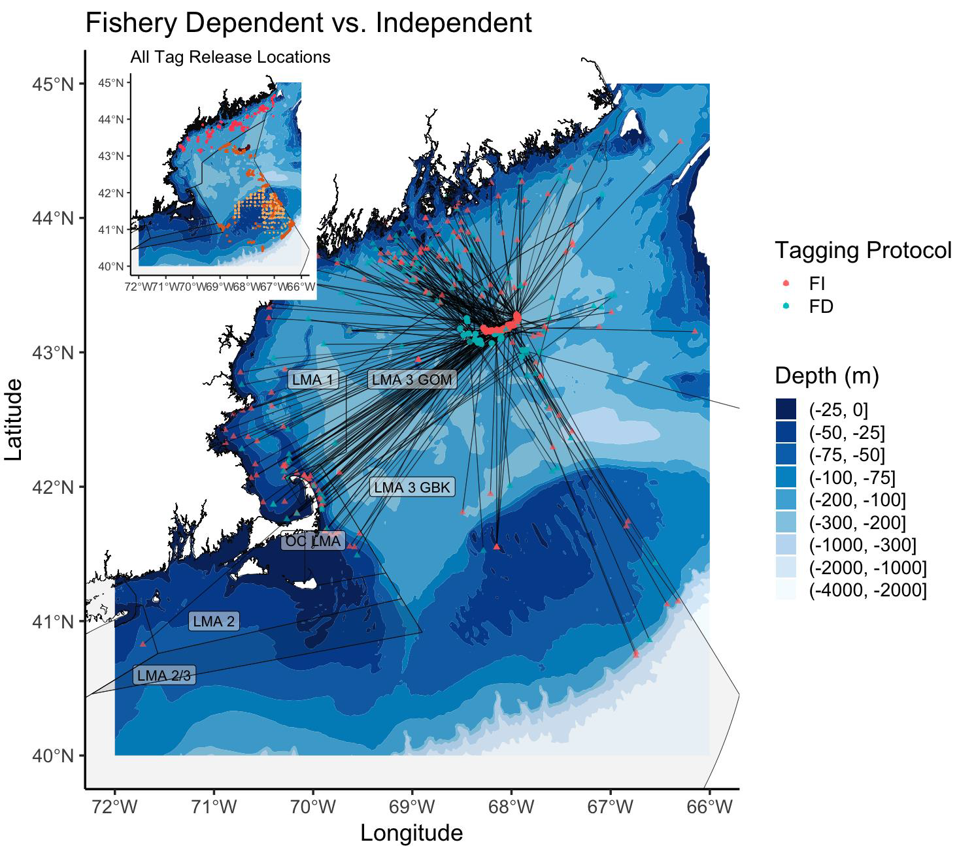
Fishery Dependent vs Independent Collaboration
Most project tagging was contracted (Area 3) or opportunistic (Area 1) on fishery dependent sampling trips
Component of expanded tagging was fishery independent
to tag both legal and discarded catch
in a location where fishing effort was limited to allow more movement/time at large
Collaboration to determine location
LMA 3 captain for information on where and when
Also shared info on how to fish the area (bait, anchors, etc)
Collaboration with LMA 1 captain for day trips to area
Maine vessel determined through RFP
ME DMR provided traps, he provided rigging

Slide 8
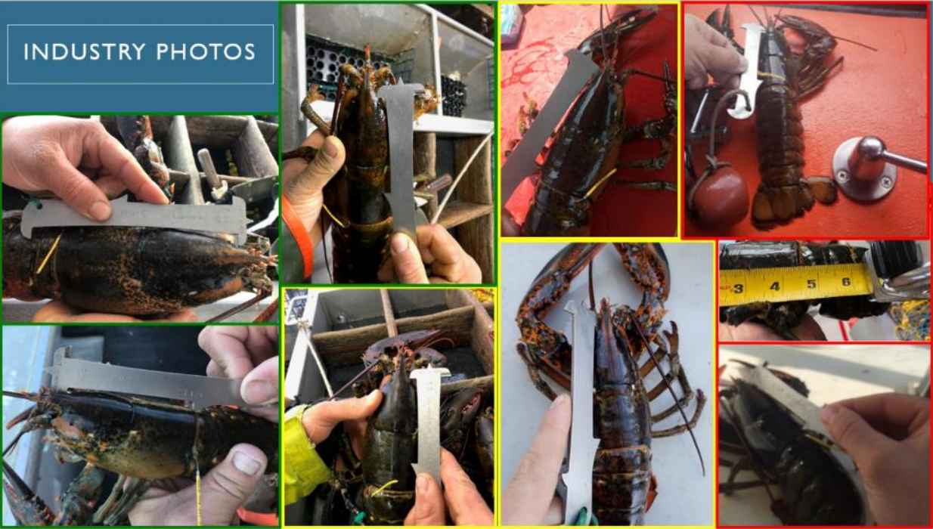
ImageJ
Images provide simpler method of data collection
Image J software used to estimate length from images
Varying quality of pictures
Developed protocol for ranking image quality to be considered in analysis
Some fishermen were able to measure & photograph
Provides opportunity to compare methods

Slide 9
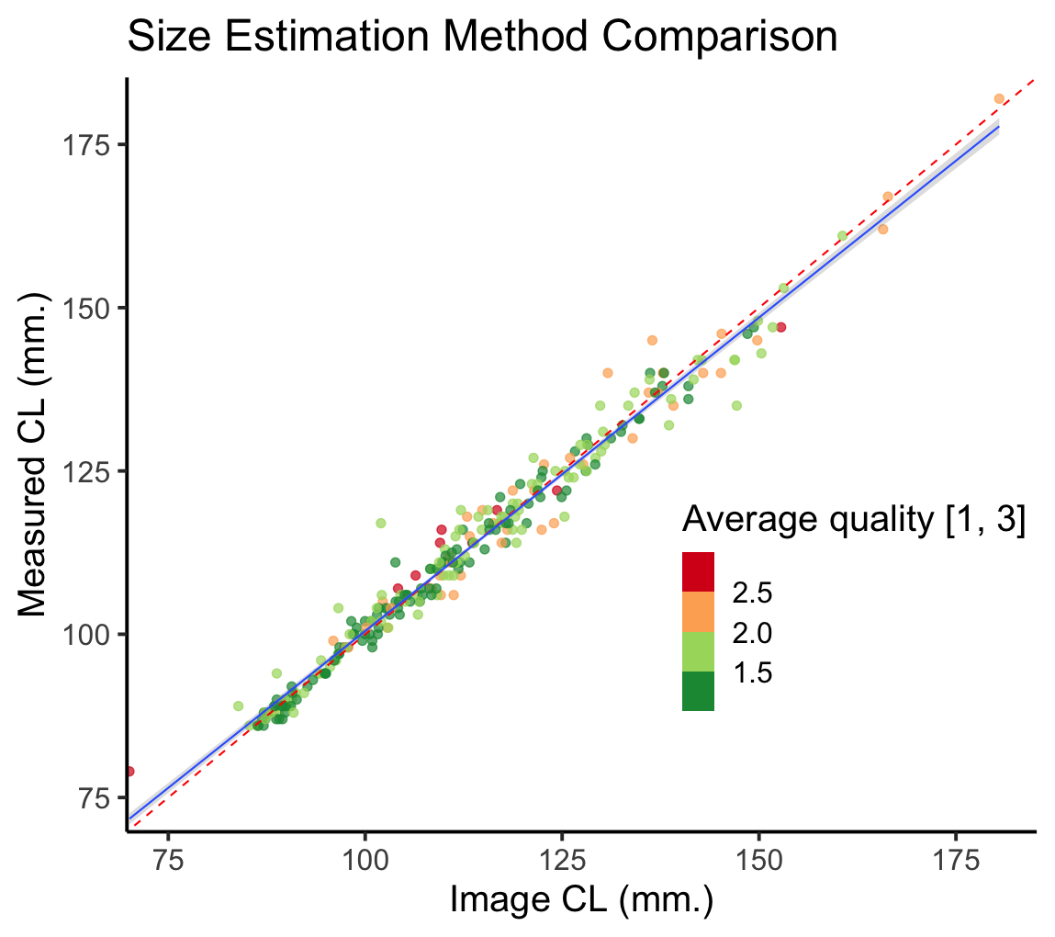
ImageJ results
Comparing direct measures with photographs we found that images can reliably estimate size.
Historically it is difficult to get growth data from tagging projects.
Expanding this type of data collection can give more data on how lobsters grow (a main objective).
Results from analysis comparing Image estimate length and Measured length.

Slide 10
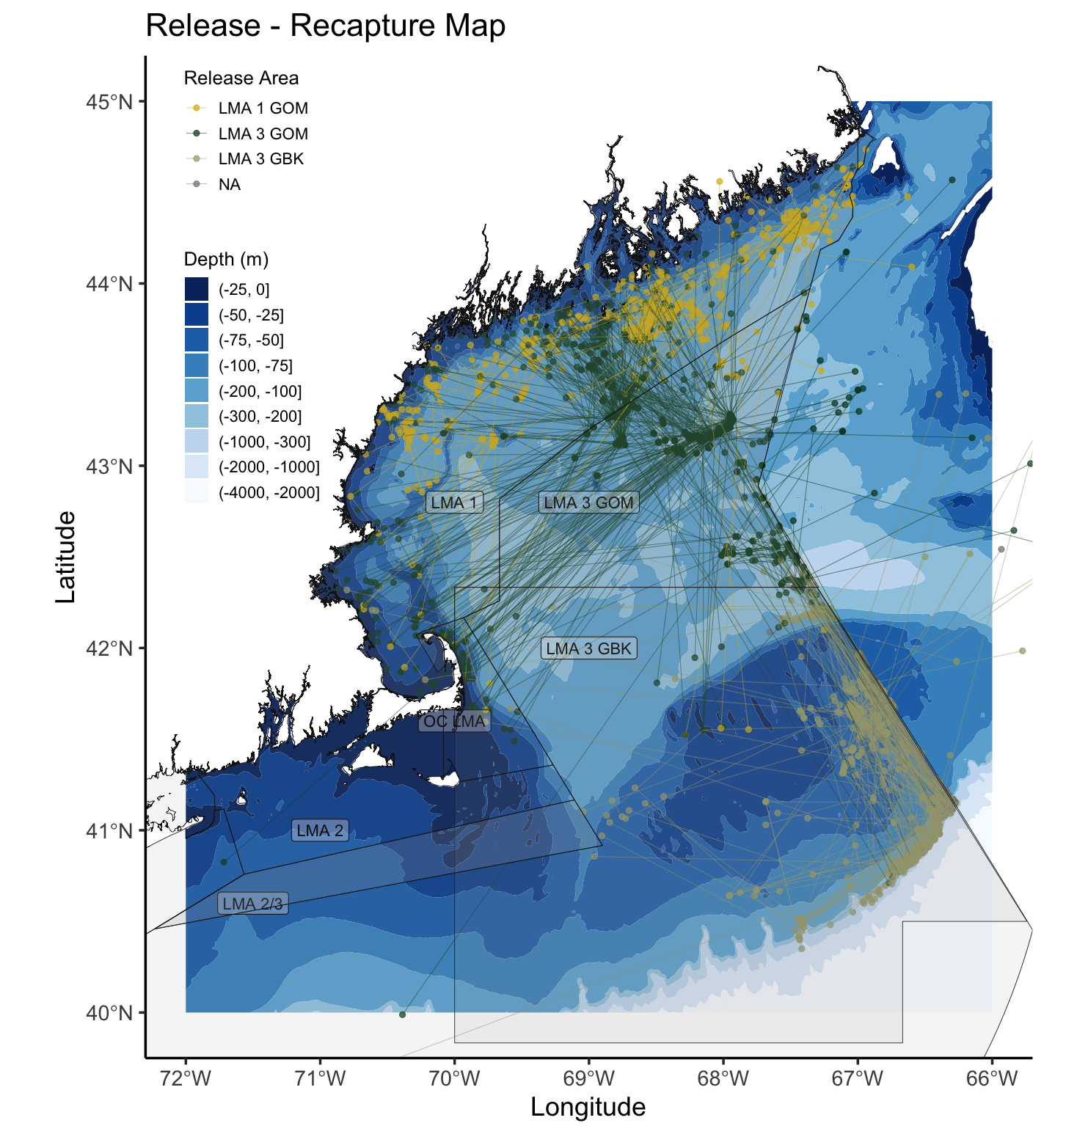
Stock Connectivity Results
GOM and GBK lobsters are exchanging but not at the rate expected.
This information will be communicated to ASMFC Stock Assessment Technical Committee to inform the stock connectivity working group.
Tag movement results.

Slide 11
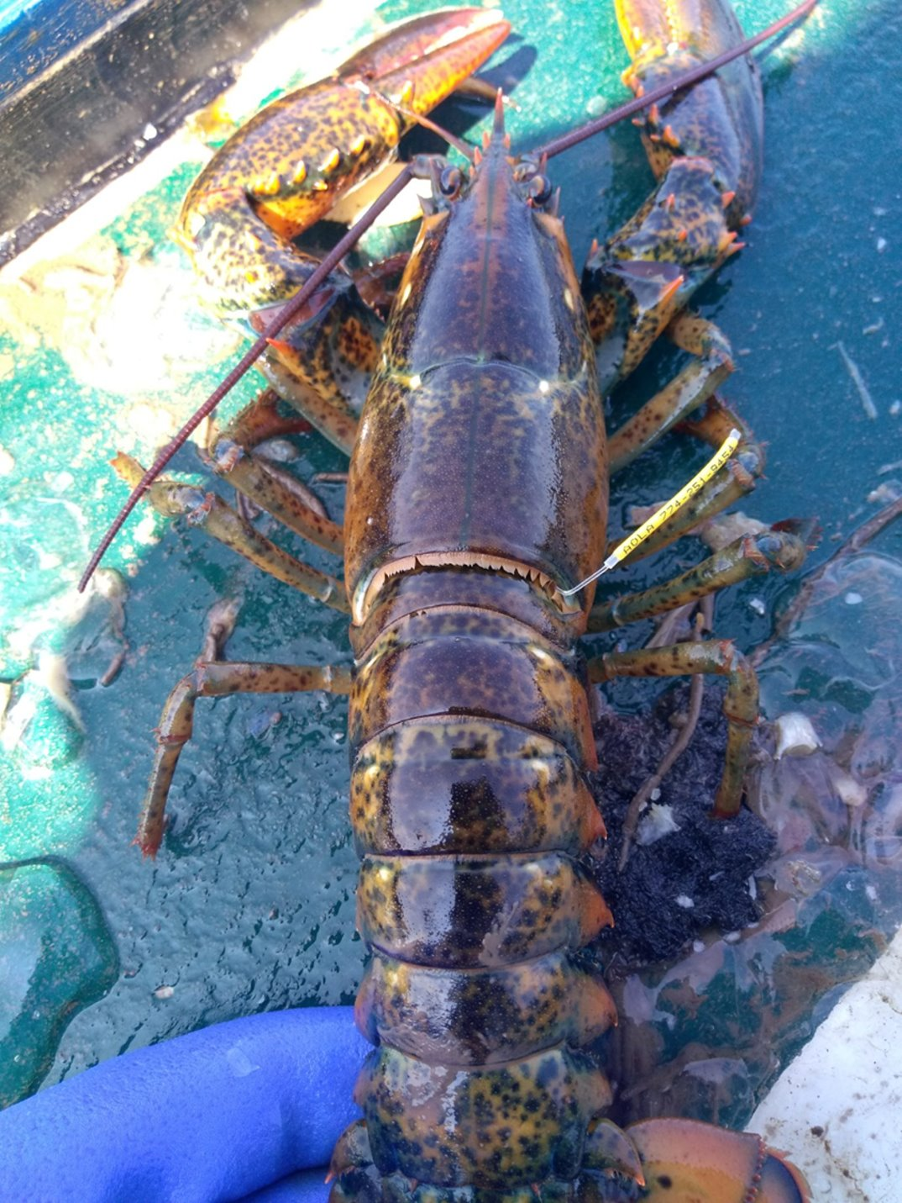
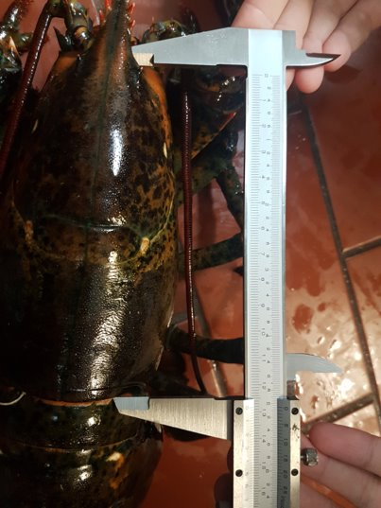
Working Together
Field coordination of tagging effort
Industry tag / image returns
Initial data analysis
Secondary data analysis
Communication
Industry submitted recapture images.

Slide 12
Next Steps
Present work related to connectivity and estimating error on length observations to the Stock Assessment Technical Committee, inform management.
Using this work to inform future work, lobster tagging in RI and MA.
Continued outreach with fishing community with emphasis on results from citizen science data collection.

Slide 13
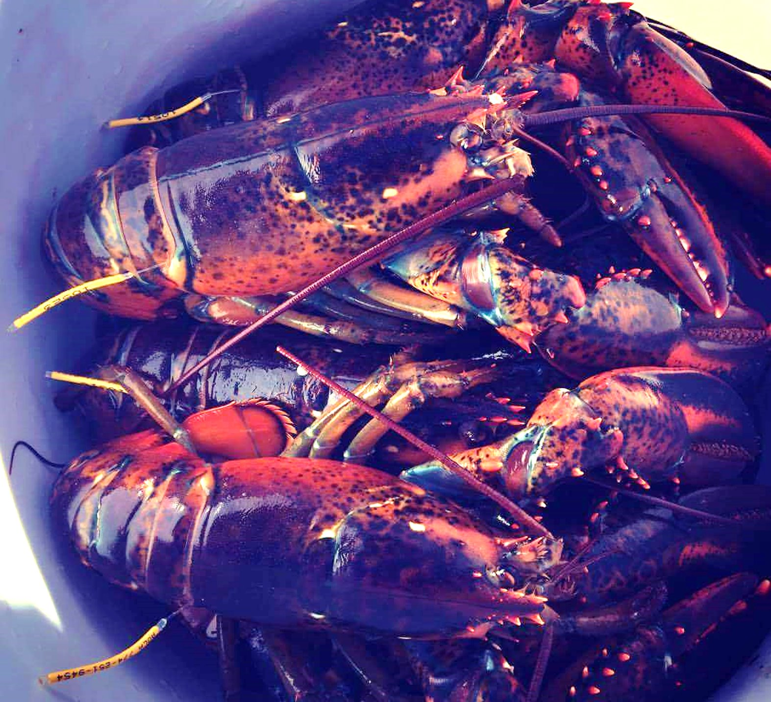
Thank you!
Discussion and Questions

